Slide 1
Data Structures (Lab-3)
Linked Lists Part 1

Slide 2
Review on Arrays
An array stores a sequence of values.
Drawbacks:
Capacity of array fixed (it doesn’t change)
Must know max number of values at compile time
Either the program runs out of space or wastes space
Arrays hold data of the same data type
* Recall that a static data structure has a fixed size

Slide 3
Dynamic Data Structures
Hold an unknown number of elements. (capacity can grow and shrink as program runs).
Generic type data structures hold data elements of different data types.
Examples:
Linked Lists
Stacks
Queues
Trees

Slide 4
Linked Lists (P.1)

Slide 5
Agenda for Today
What is Linked List
Singly Linked List & Creation
Traversing - SLL
Insertion - SLL
Deletion - SLL
Example
Task

Slide 6
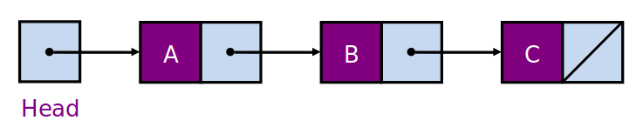
Linked List
A linked list is a series of connected nodes
Each node contains at least:
A piece of data (any type)
Pointer to the next node in the list
Head: pointer to the first node
The last node points to NULL

Slide 7
Important Terms
A node’s successor is the next node in the sequence
The last node has no successor
A node’s predecessor is the previous node in the sequence
The first node has no predecessor
A list’s length is the number of elements in it
A list may be empty (contain no elements)

Slide 8
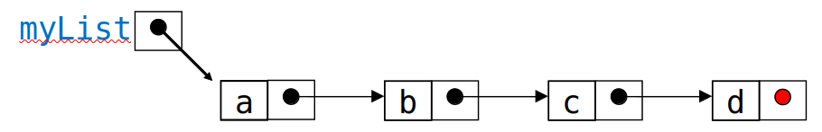

Singly Linked List (SLL)
Each node contains a value and a link to its successor (the last node has no successor)
The head points to the first node in the list (or contains the null link if the list is empty)

Slide 9
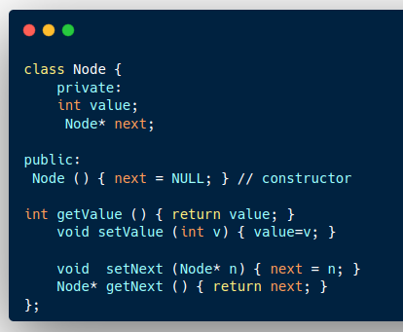
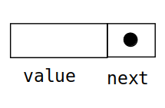
SLL - Simple Example

Slide 10
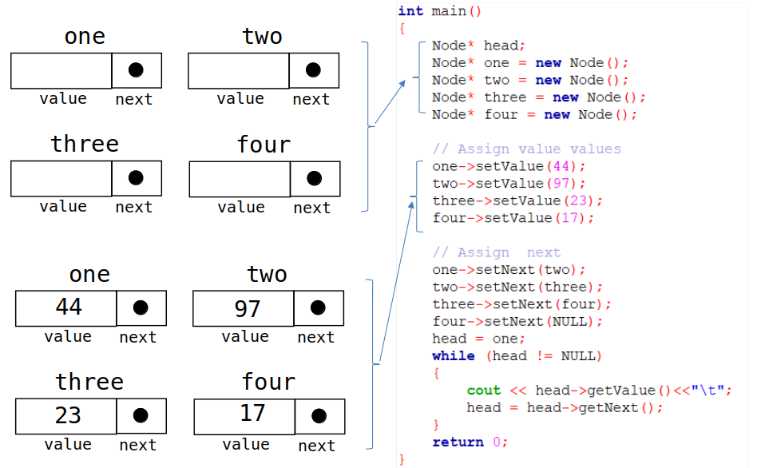

Slide 11
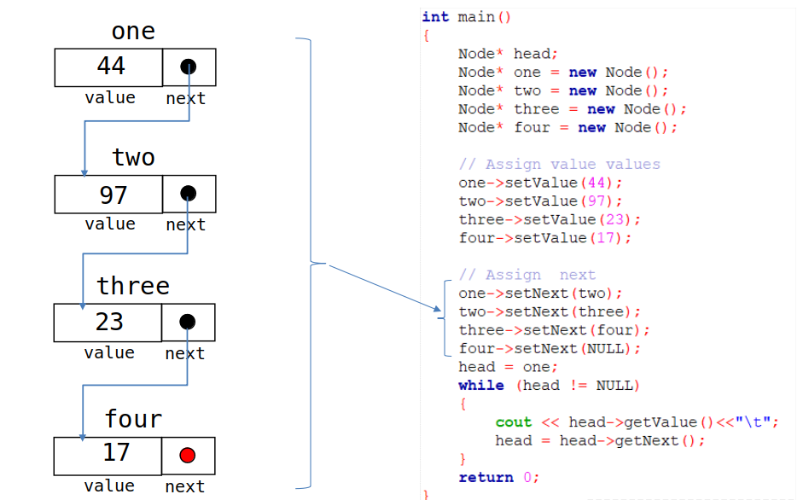

Slide 12
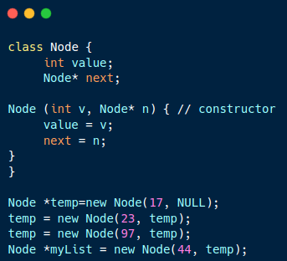
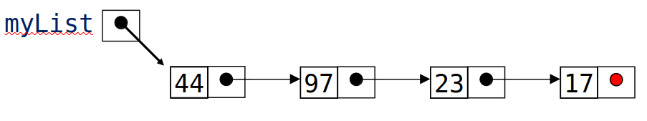

Slide 13
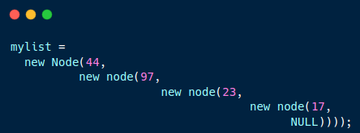
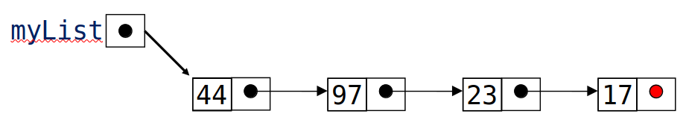

Slide 14
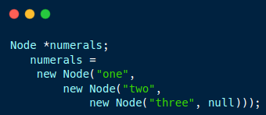
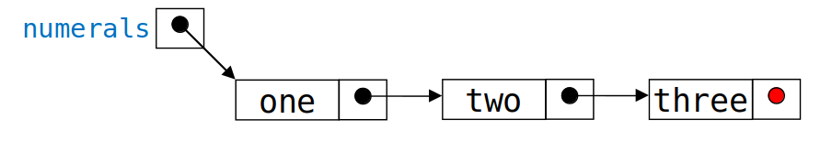
To create the list with ("one", "two", "three")

Slide 15
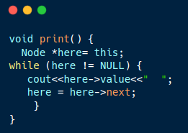
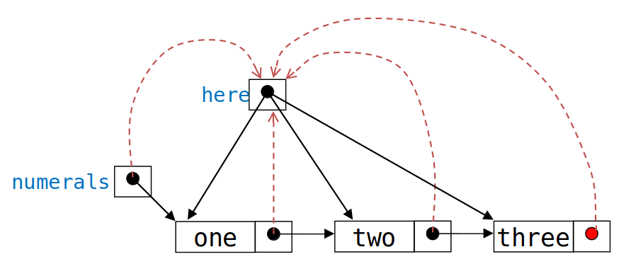
Traversing SLL
The following method traverses a list (and prints its elements):
* You can write this as a function of the Node class [In main() you can write myList.print();]

Slide 16
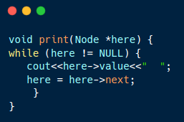
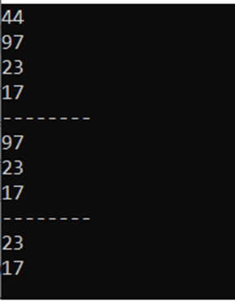
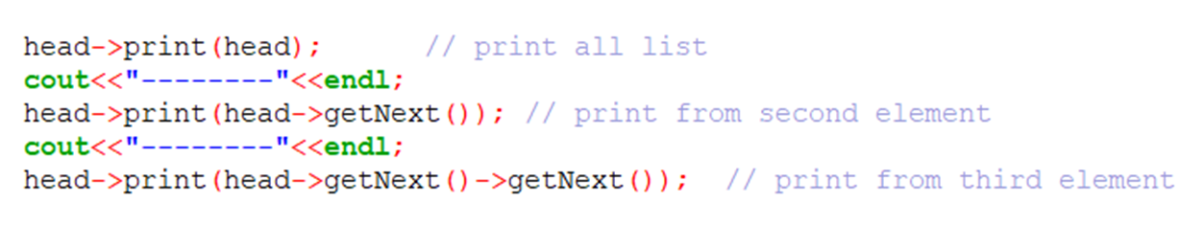
The following method traverses a list from a specific point onwards (and prints its elements):
In main(), you can write:

Slide 17
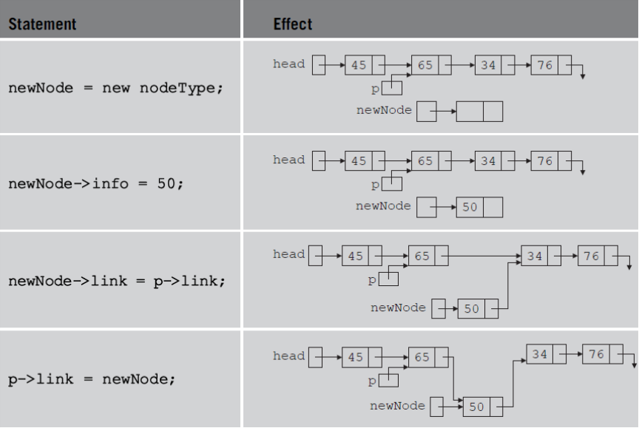
CONT. Insertion in SLL

Slide 18
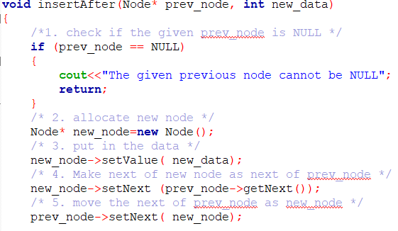
Insertion - Example
head
To insert new node between 97 and 23:
44
97
23
17

Slide 19
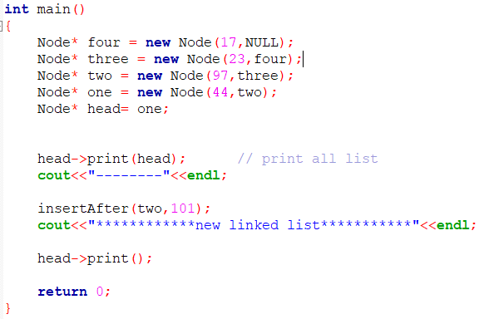
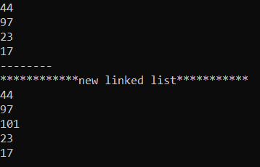
Insertion - Example
head
101
To insert new node between 97 and 23:
44
97
23
17

Slide 20
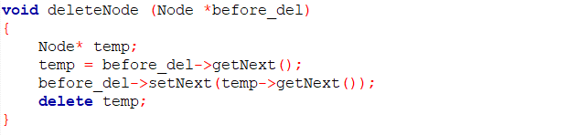
Deletion Example
• To delete some other element, change the link in its predecessor
head
(predecessor)
44
97
23
17

Slide 21
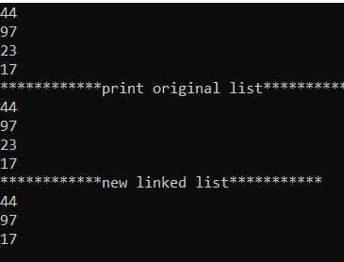
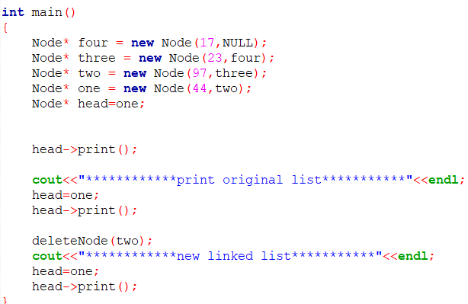
Deletion Example
head
44
97
17

Slide 22
Example on SLL
Create a Linked List class.
(Contains linked list operations)
Create a Node class.
(Represents the node of a linked list)
Define & Implement a method to add nodes at the end of the linked list.
(The method accepts the value you want to add to the LL as int parameter)
Define & Implement a method to remove a node from a certain position.
(Note: Position starts from 1)
(The method accepts the position to delete from)

Slide 23
Task of Today
YOU HAVE A METHOD THAT TAKES A VALUE TO SEARCH FOR IN A LINKED LIST
You’re requested to implement this method.
The method takes int parameter, the value to search for.
The method also takes the head of the LL to start searching from.
The method returns true if the value exits.
The method returns false if the value doesn’t exist.

Slide 24
Thank you.

